Slide 1
EXISTING PROBLEM
Can Windmills Satisfy the Company’s electricity need
If then when we can say it is suitable ?
How to save the company’s money spending on the electricity on this problem?

Slide 2
SOLUTION
Using the technology effectively
Forecasting the values as Prediction of future values
Machine learning

Slide 3

IBM CLOUD

Slide 4
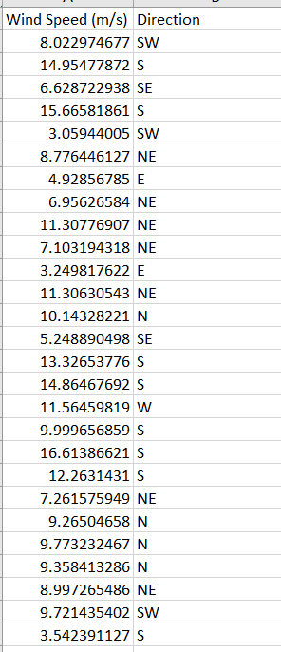
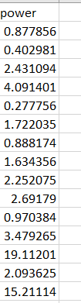
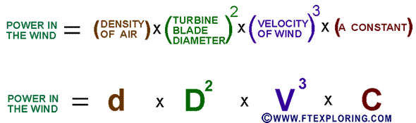
STARTING WITH MACHINE LEARNING
DATASET

Slide 5
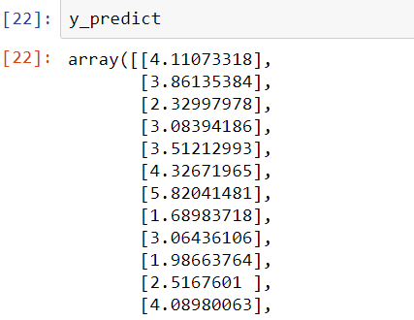
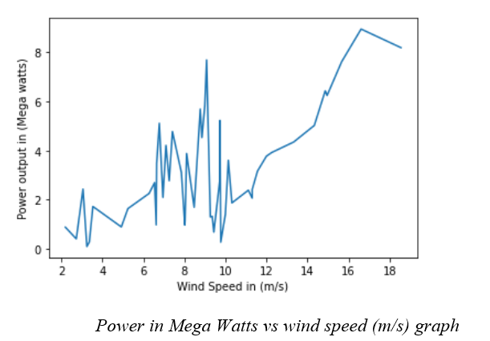
DEPLOYMENT AND ANALYSIS
MULTI LINEAR REGRESSION

Slide 6
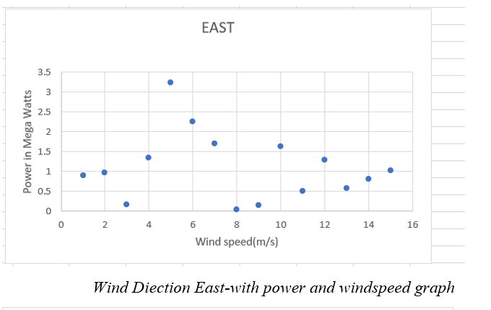
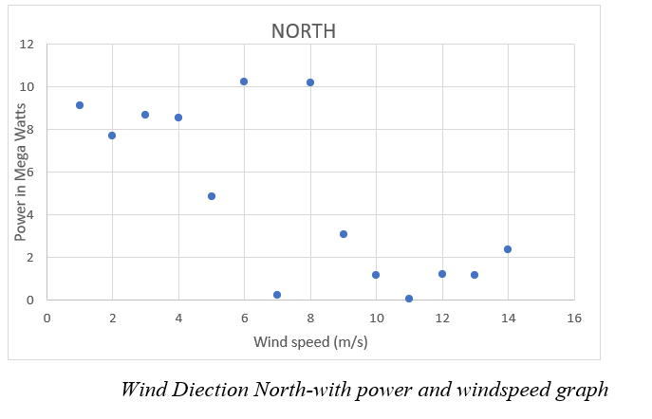
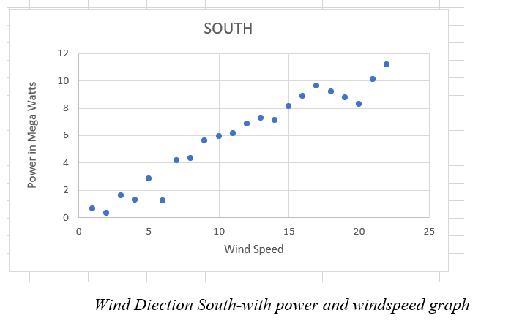
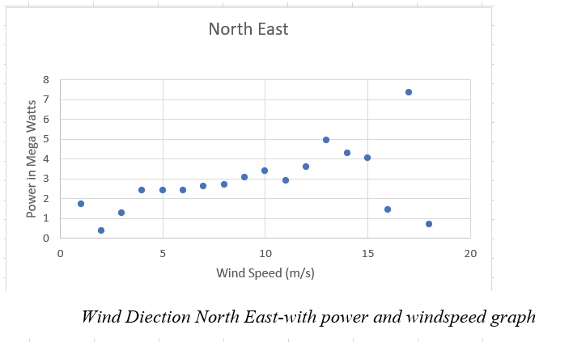
Relationship with the Wind direction

Slide 7
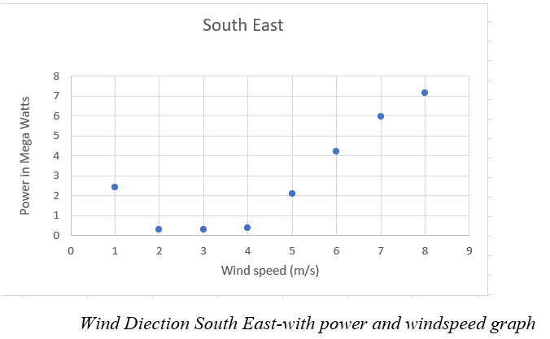
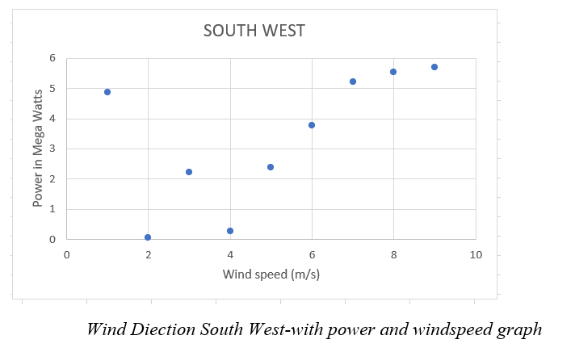
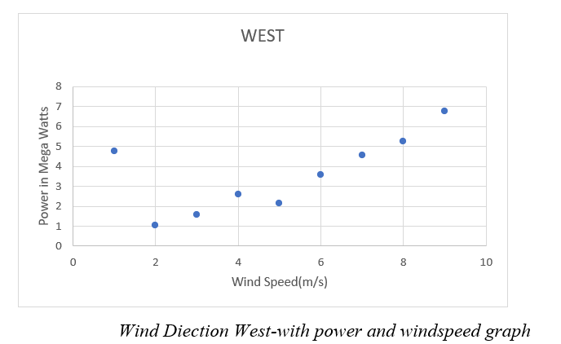
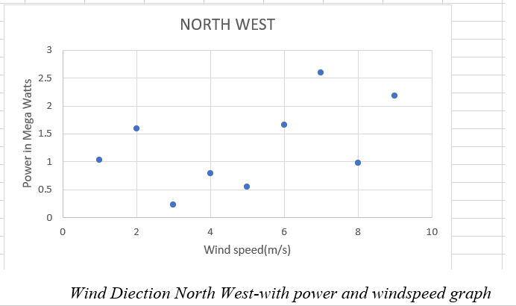

Slide 8
RESULT
North and South gives the better output power as greater than 10 Megawatts
On the direction such as Northeast, West, South East, and Southwest gives the moderate output results as ranges between (0-8) Megawatts.
As the remaining direction such as East and Northwest gives the poor output results on the inputs

Slide 9
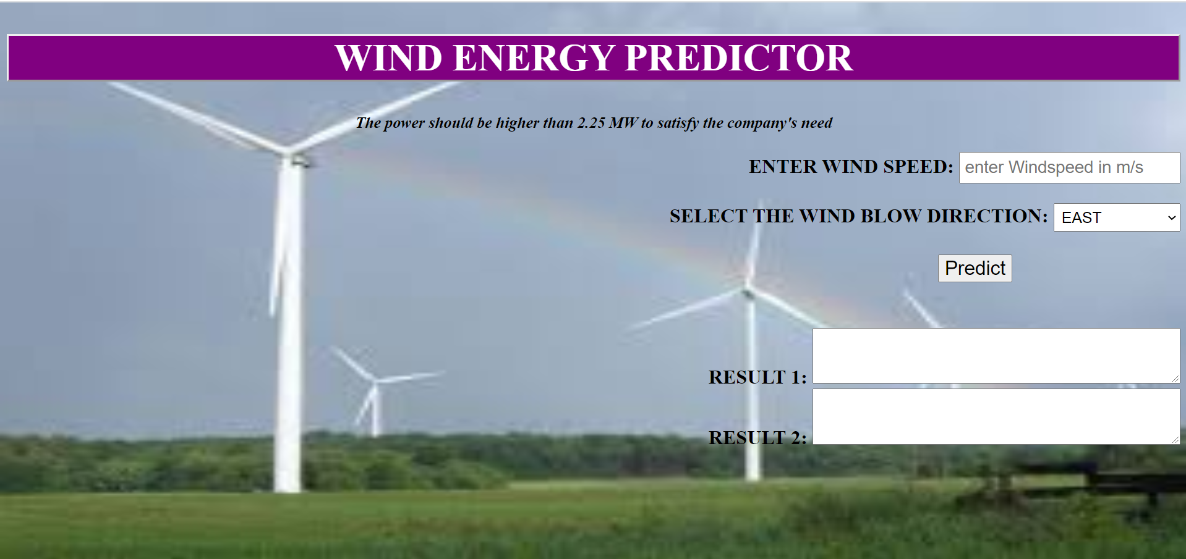
Getting started with User Interface (python flask)
For user understanding
Better Readability of output data

Slide 10
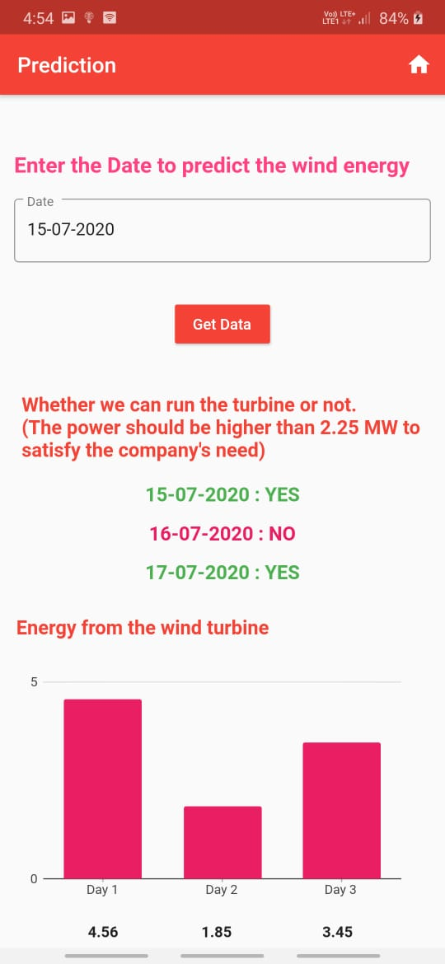
Getting started with APP(Flutter)
Better than UI
Mobility in getting information

